Slide 1
Jetson Nano 2
https://t.ly/J6If

Slide 2
安裝VSCode
安裝Anaconda
建立虛擬環境
安裝Opencv
安裝tensorflow(gpu)
練習teachable machine
匯出模型至Jetson上執行

Slide 3
安裝遠端控制：VINO
一、安裝VINO：VNC Server
sudo apt update
sudo apt install vino
二、設定VINO登入選項
gsettings set org.gnome.Vino prompt-enabled false
gsettings set org.gnome.Vino require-encryption false
三、將網路卡加入VINO服務
nmcli connection show，會顯示網路卡的UUID，把他填入下方的' '之間
dconf write /org/gnome/settings-daemon/plugins/sharing/vino-server/enabled-connections "['UUID of the ethernet']"
export DISPLAY=:0
四、啟動VINO服務
/usr/lib/vino/vino-server
參考網址：https://youyouyou.pixnet.net/blog/post/119567170

Slide 4
安裝VSCode
到Vscode網站下載Arm64版本安裝即可

Slide 5
安裝Archiconda(Anaconda)
到網址：https://github.com/Archiconda/build-tools/releases/tag/0.2.3
下載Archiconda3-0.2.3-Linux-aarch64.sh
It downloaded to /Download folder
In terminal:
進入download資料夾後輸入指令
bash Archiconda3-0.2.3-Linux-aarch64.sh
---------命令列--------------
wget https://github.com/Archiconda/build-tools/releases/download/0.2.3/Archiconda3-0.2.3-Linux-aarch64.sh
sh Archiconda3-0.2.3-Linux-aarch64.sh

Slide 6
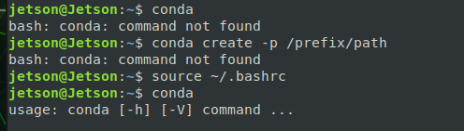
更新路徑
conda無法執行時
source ~/.bashrc

Slide 7
建立虛擬環境1
測試Conda指令
conda --version
conda 4.5.12
列出現有環境
conda env list
# conda environments:
base * /home/jetson/archiconda3
顯示Python版本
python3 --version
Python 3.7.1

Slide 8
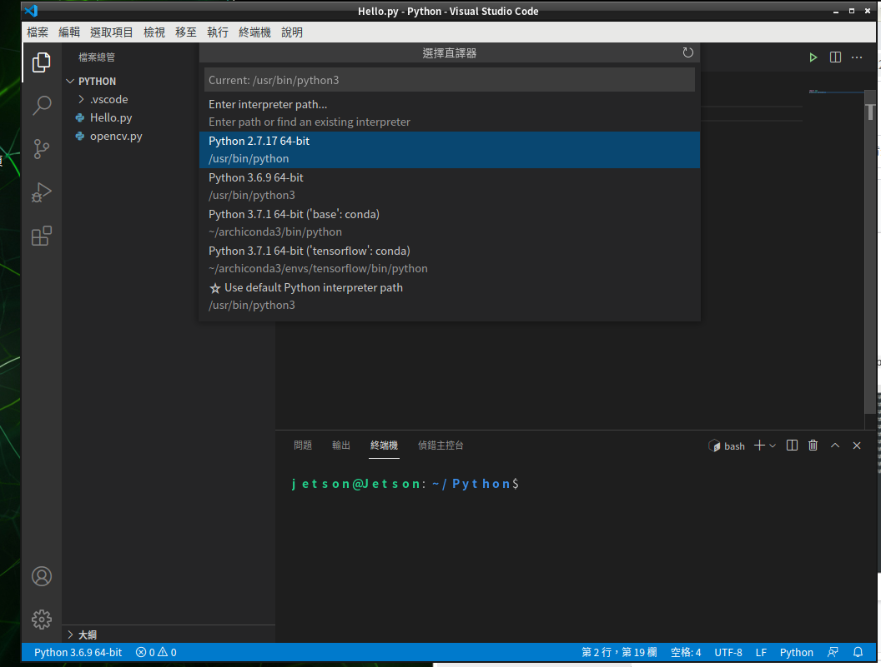
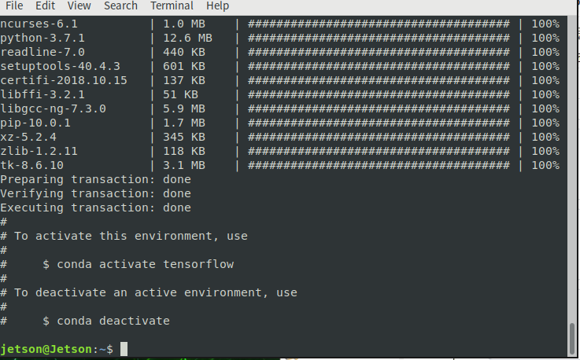
建立虛擬環境2
建立環境
conda create --name tensorflow python=3.6.9

Slide 9
虛擬環境操作
1.進入虛擬環境
source activate tensorflow
2.退出虛擬環境
source deactivate
3.刪除虛擬環境
conda env remove --name tensorflow

Slide 10
安裝Opencv
先更新Pip版本：
pip install --upgrade pip
安裝opencv
pip install opencv-contrib-python
PS.最新版本與csi鏡頭不相容，須安裝編譯舊版opencv 4.4.1…..
https://github.com/JetsonHacksNano/CSI-Camera/issues/3

Slide 11
測試opencv
開啟一個新的python檔案
輸入一下內容
import cv2
print(cv2.__version__)
如果出現： illegal instruction (core dumped)
將numpy更改為1.19.4
pip install numpy==1.19.4

Slide 12
開啟webcam
import cv2
# 選擇攝影機
cap = cv2.VideoCapture(0)
while cap.isOpened():
# 從攝影機擷取一張影像
ret, frame = cap.read() #ret=retval,frame=image
# 顯示圖片
cv2.imshow('frame', frame)
# 按a拍照存檔，按q離開
key=cv2.waitKey(1)
if key & 0xFF == ord('a'):
cv2.imwrite("test.jpg", frame)
if key & 0xFF == ord('q'):
break
# 釋放攝影機
cap.release()
# 關閉所有 OpenCV 視窗
cv2.destroyAllWindows()

Slide 13
CPU版人臉識別

Slide 14
口罩辨識

Slide 15
安裝tensorflow-gpu
https://docs.nvidia.com/deeplearning/frameworks/install-tf-jetson-platform/index.html
版本對照：https://docs.nvidia.com/deeplearning/frameworks/install-tf-jetson-platform-release-notes/tf-jetson-rel.html#tf-jetson-rel
JP45版
https://developer.download.nvidia.com/compute/redist/jp/v45/tensorflow/

Slide 16
先進入虛擬環境，使用終端機視窗
安裝相依套件：
sudo apt-get update
sudo apt-get install libhdf5-serial-dev hdf5-tools libhdf5-dev zlib1g-dev zip libjpeg8-dev liblapack-dev libblas-dev gfortran
pip install -U pip testresources setuptools==49.6.0
pip install -U numpy==1.19.4 future==0.18.2 mock==3.0.5 h5py==2.10.0 keras_preprocessing==1.1.1 keras_applications==1.0.8 gast==0.2.2 futures protobuf pybind11
------安裝Tensorflow---------------------------------------
pip install -U numpy grpcio absl-py py-cpuinfo psutil portpicker six mock requests gast h5py astor termcolor protobuf keras-applications keras-preprocessing wrapt google-pasta setuptools testresources
pip install --extra-index-url https://developer.download.nvidia.com/compute/redist/jp/v45 tensorflow==2.3.1+nv20.12

Slide 17
測試GPU
先進入Python
import tensorflow as tf
from tensorflow.python.client import device_lib
print(tf.__version__)
print(device_lib.list_local_devices())

Slide 18
分類器
Python：https://drive.google.com/file/d/1TikqkL6I70atkzd-d3IlBDDd5ioRRYVx/view
h5模型檔：
https://drive.google.com/file/d/1cClCogcTduExg3cOGUOwAE2W1ylrwdRD/view?usp=sharing

